Slide 1
22. Materialization and Sorting
Ilhyun Suh

Slide 2
Contents
Materialization
Temporary Table
Product Operator
Cost
Sorting
Algorithm & Cost
Implementation
GROUP BY Operator
Algorithm & Cost
Implementation
Join
Algorithm & Cost
Implementation

Slide 3
Contents
Materialization
Temporary Table
Product Operator
Cost
Sorting
Algorithm & Cost
Implementation
GROUP BY Operator
Algorithm & Cost
Implementation
Join
Algorithm & Cost
Implementation

Slide 4
The Value of Materialization
Every operator so far implemented
Records are computed one at a time (not saved)
To access a previously seen record, it must be recomputed
This chapter considers implementation materializing their input
First compute their input records, and save them in temporary table(s)
Preprocess

Slide 5
Temporary Tables
A temporary table differs from a regular table
Not managed by table manager (not shown in system catalog)
Automatically deleted by the system when they are no longer needed
In SimpleDB, it is deleted during initialization
No logging
No recovery
Temp table is implemented in a simple way, independent from the table manager

Slide 6
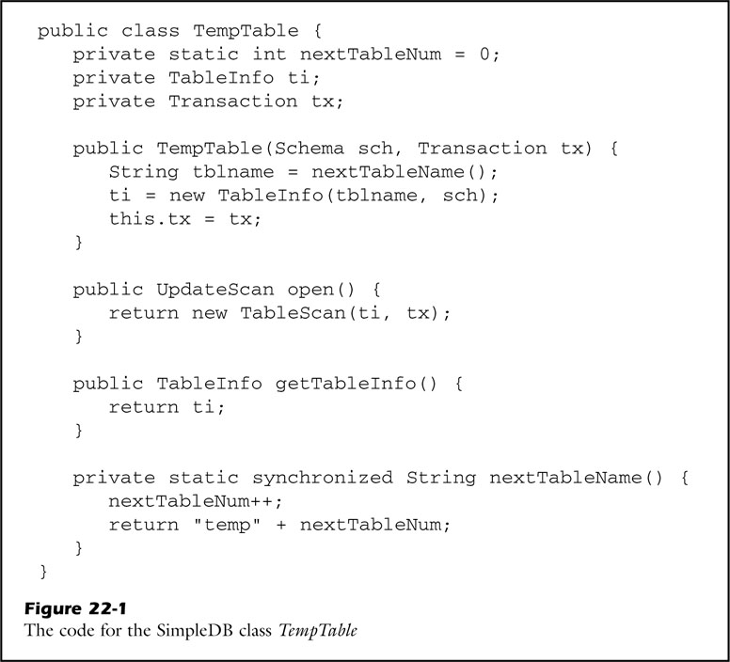
Temporary Table

Slide 7

Materialization
Relational operator
$materialize(Q)≡Q$
Unary operator
Output records are exactly same as the input records
Purpose is to save the ouput of a subquery in a temp table

Slide 8
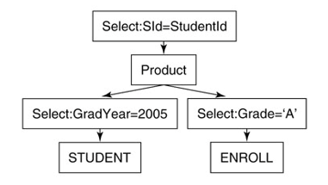
Product Operator (w/o materialization)
Remind the product operator in Chapter 17
σ_{SId=StudentId} ((σ_{GradYear=2005}(STUDENT)) X (σ_{Grade=‘A’}(ENROLL)))
Plan (nested loop)
SId | SName | GradYear | MajorId
0 | Suh | 2005 | 2
1 | Guan | 2014 | 2
2 | Shim | 2005 | 2
3 | Shim | 2014 | 2
EId | StudentId | SectionId | Grade
0 | 0 | 13 | A
1 | 1 | 13 | A
2 | 2 | 13 | B
3 | 3 | 13 | B
Table ‘STUDENT’
Table ‘ENROLL’
SId | SName | GradYear | MajorId | EId | StudentId | SectionId | Grade
0 | Suh | 2005 | 2 | 0 | 0 | 13 | A
Output

Slide 9
Product Operator (w/o materialization)
σ_{SId=StudentId} ((σ_{GradYear=2005}(STUDENT)) X (σ_{Grade=‘A’}(ENROLL)))
Plan (nested loop)
Cost
Assumptions
4,500 STUDENT table blocks
50,000 ENROLL table blocks
900 students in the class of 2005
Then, 900 X 50,000 + 4,500 = 45,004,500 block accesses

Slide 10
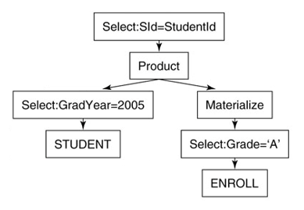
Product Operator (with materialization)
σ_{SId=StudentId} ((σ_{GradYear=2005}(STUDENT))
X materialize(σ_{Grade=‘A’}(ENROLL)))
Plan
SId | SName | GradYear | MajorId
0 | Suh | 2005 | 2
1 | Guan | 2014 | 2
2 | Shim | 2005 | 2
3 | Shim | 2014 | 2
EId | StudentId | SectionId | Grade
0 | 0 | 13 | A
1 | 1 | 13 | A
2 | 2 | 13 | B
3 | 3 | 13 | B
Table ‘STUDENT’
Table ‘ENROLL’
EId | StudentId | SectionId | Grade
0 | 0 | 13 | A
1 | 1 | 13 | A
Temp Table

Slide 11
Product Operator (with materialization)
σ_{SId=StudentId} ((σ_{GradYear=2005}(STUDENT))
X materialize(σ_{Grade=‘A’}(ENROLL)))
Plan
Cost
Assumptions
4,500 STUDENT table blocks
50,000 ENROLL table blocks
900 students in the class of 2005
1/14 has grade ‘A’ in ENROLL table
53,572 block accesses to create temp table (temp table = 3,572 blocks)
Then 53,572 + (900 X 3,572) +4,500 = 3,272,872

Slide 12
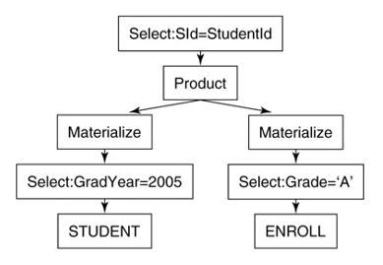
Product Operator (with materialization)
σ_{SId=StudentId} (materialize(σ_{GradYear=2005}(STUDENT))
X materialize(σ_{Grade=‘A’}(ENROLL)))
Plan
No
STUDENT table will be examined just once
This materialization increases the cost contrarily
Is this effective?

Slide 13
The Cost of Materialization
The cost associated with the materialization node can be divided into two parts
Assume B-block temp table is materialized
Preprocessing = B + the cost of its input
Scanning cost = B

Slide 14
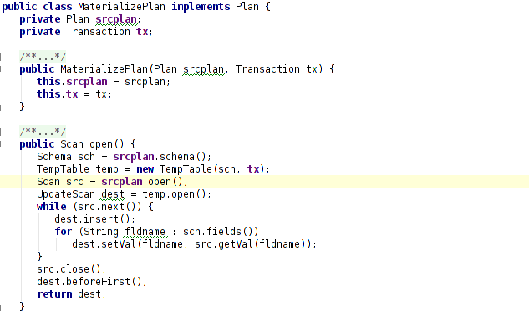
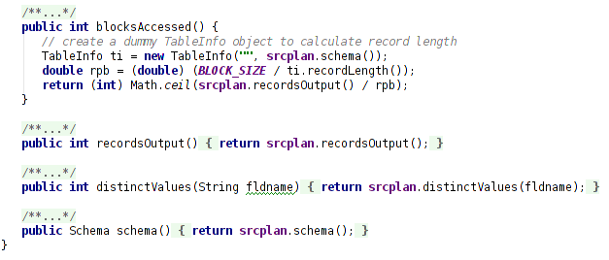
Implementing the Materialize operator

Slide 15
Contents
Materialization
Temporary Table
Product Operator
Cost
Sorting
Algorithm & Cost
Implementation
GROUP BY Operator
Algorithm & Cost
Implementation
Join
Algorithm & Cost
Implementation

Slide 16
Sorting
Sort is used for several purposes
ORDER BY clause
GROUP BY, JOIN clause
Sorting be as efficient as possible is critical
Use materialization

Slide 17
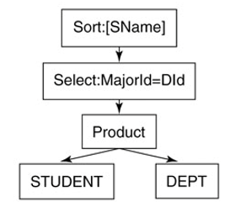
Sorting
τ_{SName}(σ_{MajorId=DId}(STUDENT X DEPT))
Plan
Without materialization, the next() method will position the scan at the record having the next largest Sname value
Must scan all of the input records

Slide 18
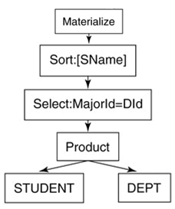
Sorting
materialize(τ_{SName}(σ_{MajorId=DId}(STUDENT X DEPT)))
Plan
With materialization, the open() method will sort the input records and save them to temp table
Preprocess once, and scan sequentially

Slide 19
Sort Algorithm
Internal sort
Requires all the records to be in memory at the same time
Insertion sort, quicksort…
External sort
Only chunks of data small enough to fit in main memory are in memory
The remaining records can reside in the slower external memory(disk)
External mergesort, distribution sort…

Slide 20
Mergesort
Mergesort is based on the concept of a run
A run is a sorted portion of a table
Sort students by their ID, SId values are in following order
2 6 20 4 1 16 19 3 18
Mergesort has two phases (Divide and Conquer)
Split : Scans the input records, places each run into its own temp table
Merge : Sequence of iterations
Iteration : Divide the current set of runs into pairs; then merge each pair of runs into a single run

Slide 21
Mergesort
Example : 2 6 20 4 1 16 19 3 18
Split phase
Run 1 : 2 6 20
Run 2 : 4
Run 3 : 1 16 19
Run 4 : 3 18
Merge phase
1st Iteration
Run 5 : 2 4 6 20
Run 6 : 1 3 16 18 19
2nd Iteration
Run 7 : 1 2 3 4 6 16 18 19 29

Slide 22
Mergesort
Suppose a table has 2^{N} initial runs
N iterations to sort
Generally, a table with R initial runs will be sorted after log₂R merge iterations

Slide 23
Improving Mergesort
1. Increasing the number of runs in a merge
Why merge only 2 runs? Let make it k ( > 2)!
With initial R runs, needs log_{k}R (< log₂R) iterations
How large k?
First of all, depends on how many buffers are available
To merge k runs, k+1 buffers are needed
Best value for k will be covered later

Slide 24
Improving Mergesort
2. Reducing the number of initial runs
To reduce to initial runs, we need to increase the number of records per run
a) create 1 block sized runs
Read 1 block worth records and sort them using internal sorting algorithm
2 6 20 4 1 16 19 3 18
Run 1 : 2 6 20
Run 2 : 4 1 16
Run 3 : 19 3 18

Slide 25
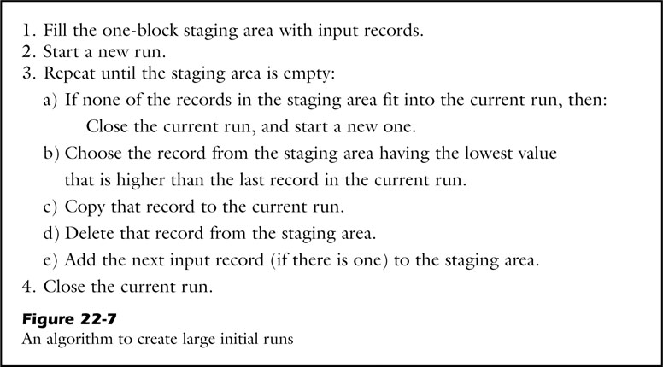
Improving Mergesort
2. Reducing the number of initial run
b) create large initial runs using staging area

Slide 26
Improving Mergesort
2. Reducing the number of initial run
b) create large initial runs using staging area
2
6
20
4
1
16
19
3
18
Staging Area
(3 rpb)
Runs

Slide 27
Improving Mergesort
3. Do not write the final sorted table
Stop the preprocessing before the final merge iteration
Open a scan for k semi-final runs and next() method examine the current record of those scans

Slide 28
Cost of Mergesort
The cost associated with the sort can be divided into two parts
Preprocessing cost
Scanning cost
Assumption
Merge k runs at a time
R initial runs
The materialized input records require B blocks

Slide 29
Cost of Mergesort
Preprocessing cost
2B block accesses per iteration
Does not write the last iteration
2B log_{k}R – B + the cost of its input
Scanning cost
Scan B blocks from the last runs
B

Slide 30
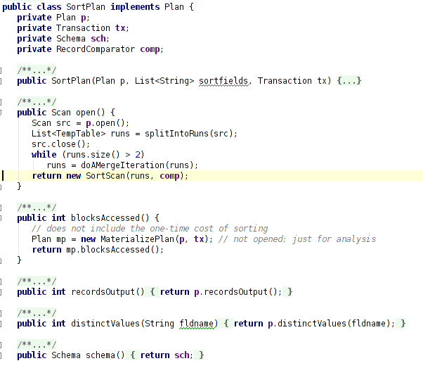
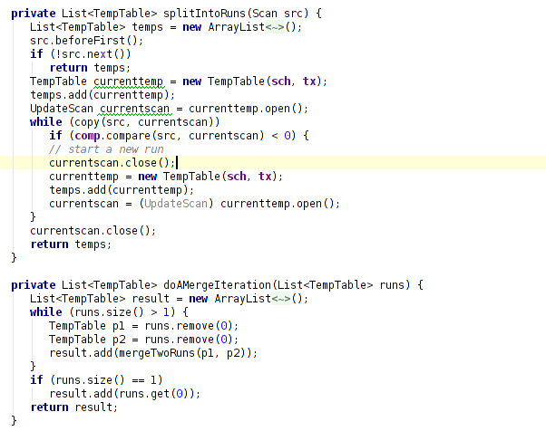
Implementing Mergesort

Slide 31
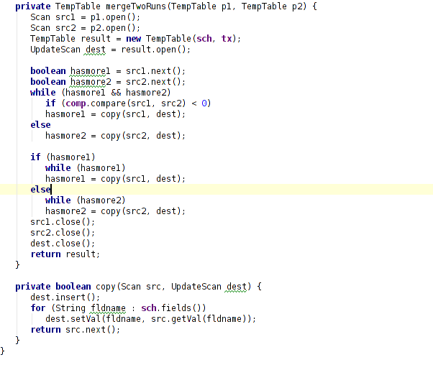
Implementing Mergesort

Slide 32
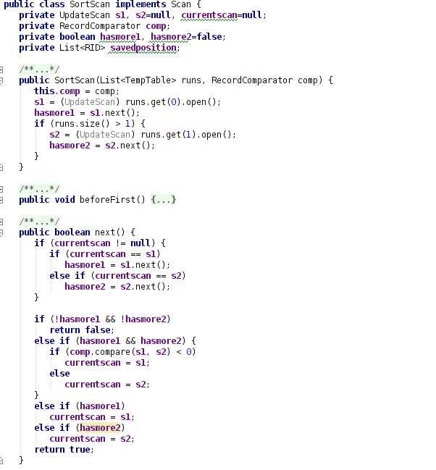
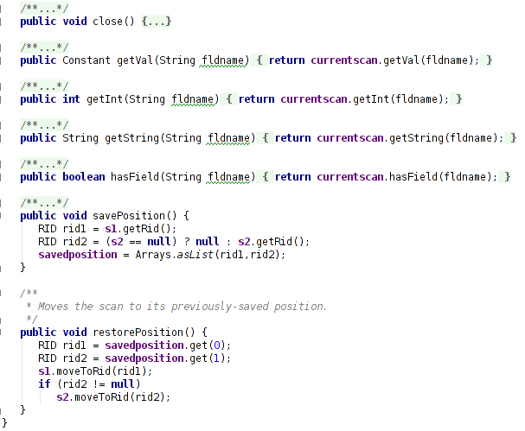
Implementing Mergesort

Slide 33
Contents
Materialization
Temporary Table
Product Operator
Cost
Sorting
Algorithm & Cost
Implementation
GROUP BY Operator
Algorithm & Cost
Implementation
Join
Algorithm & Cost
Implementation

Slide 34
Grouping and Aggregation
The groupby operator takes three arguments
An input table
A collection of grouping fields
A collection of aggregation functions
The main issue in groupby is how to determine the records in each group

Slide 35
Grouping and Aggregation
A nonmaterialized implementation
For each input record, examine all other input records to determine which ones belonged to the same group
A materialized implementation
Create a temporary table in which the records are sorted on the grouping fields
In this case, the cost of GROUP BY is identical to that of sort

Slide 36
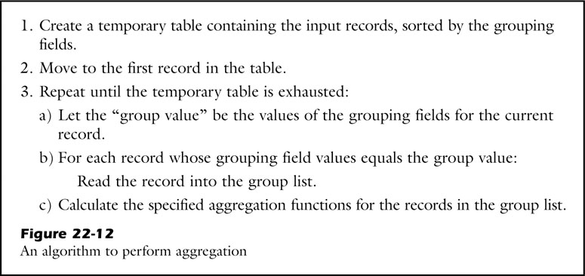
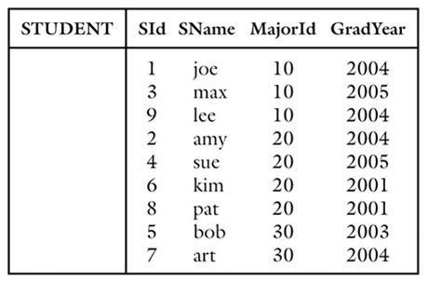
Grouping and Aggregation
Algorithm

Slide 37
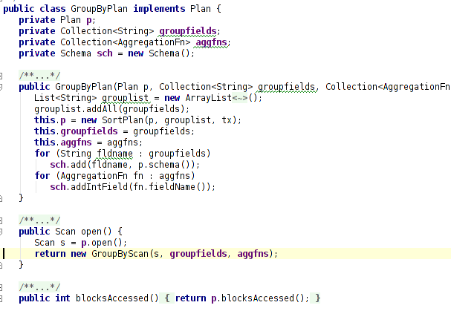
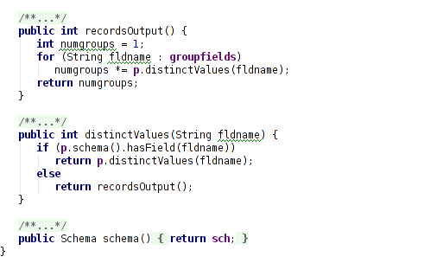
Implementing Groupby

Slide 38
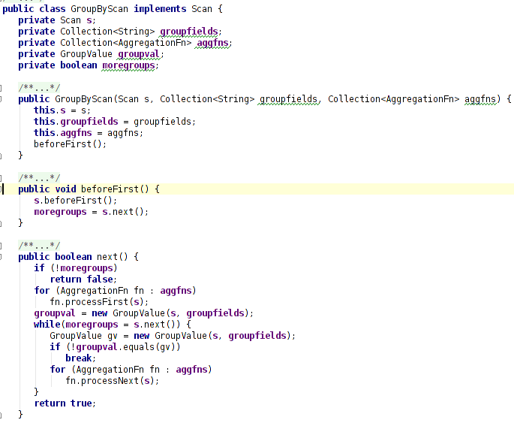
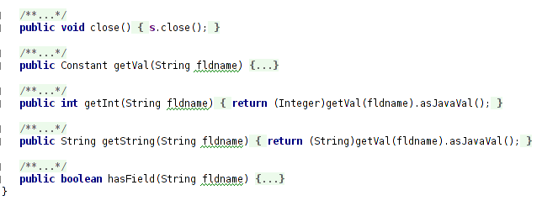
Implementing Groupby

Slide 39
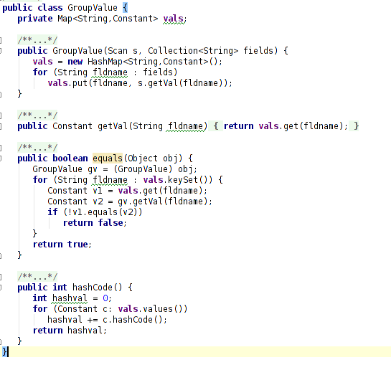
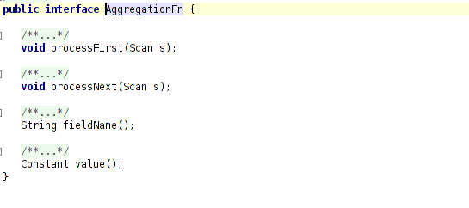
Implementing Groupby

Slide 40
Contents
Materialization
Temporary Table
Product Operator
Cost
Sorting
Algorithm & Cost
Implementation
GROUP BY Operator
Algorithm & Cost
Implementation
Join
Algorithm & Cost
Implementation

Slide 41
Merge Joins
Basic query planner of Chapter 19 computes a join as a selection of a product
Computes product first
Perform selection using the join predicate
We examine an efficient materialized implementation for equijoin

Slide 42
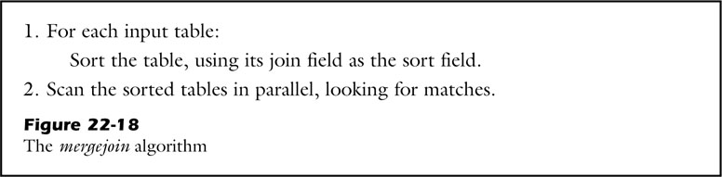
Mergejoin Algorithm
The join operator takes three arguments
Two input tables
An arbitrary join predicate
Algorithm

Slide 43
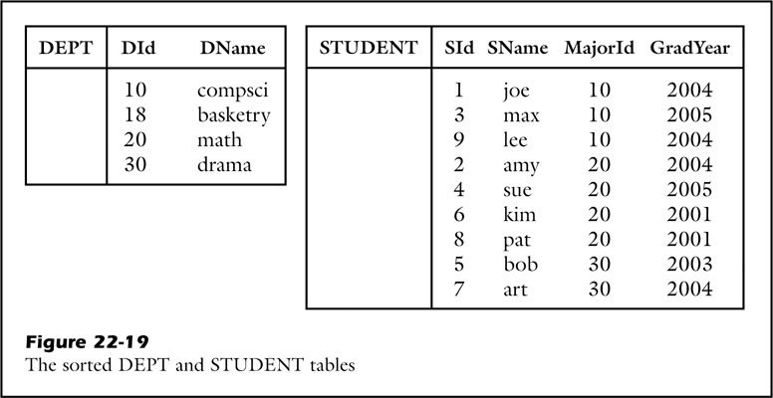
Mergejoin Algorithm
Example – join(DEPT, STUDENT, Did=MajorId)

Slide 44
Merge Joins Algorithms
Duplicate left values?
We need to move back the right-side record
Fortunately, duplicate left-side values rarely occurs
Most joins tend to be relationship joins
Key-foreign key relationship
Query planner can use this information and ensure that there are no duplicate left-side value ( in the case of relationship join)

Slide 45
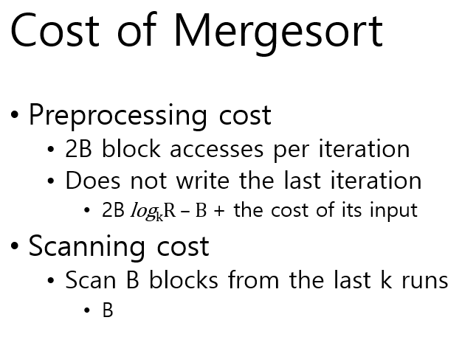
Cost of Mergejoin
Assumptions
4500 blocks for STUDENT table
2 blocks for DEPT table
Cost
Preprocessing cost
9000 * log2(4500) – 4500 + 4500
4 * log2(2) -2 + 2
117,004 block accesses
Scanning cost
4500 + 2
Total
121,506 ( < 184,500 in Chapter 17 version)

Slide 46
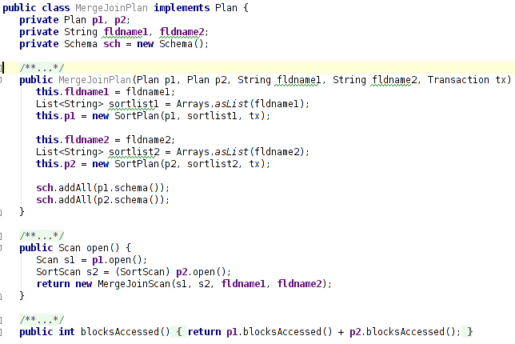
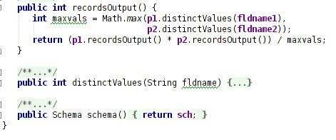
Implementing Mergejoin

Slide 47
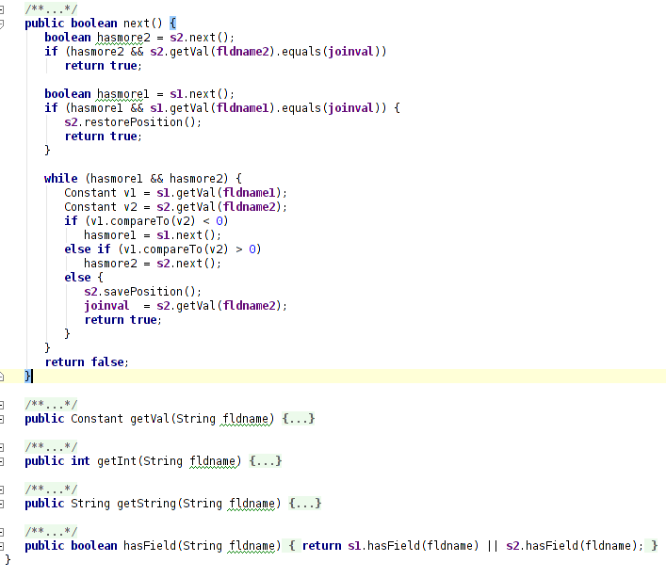
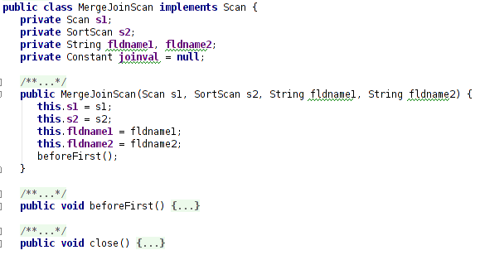
Implementing Mergejoin

Slide 48
Conclusion
Materialization
Effectiveness
Cost of materialization
PRODUCT using materialization
Sorting - Mergesort
Algorithm & Cost
Improvements
Implmentation
GROUP BY
Utilize materialized sorted table
Cost of GROUP BY
Implementation
Join - Mergejoin
Utilize materialized sorted table
Algorithm & Cost
Implmentation

